Slide 1
JNCIS-ENT
Intermediate System to Intermediate System (IS-IS)

Slide 2
IS-IS Neighbors and Adjacencies
3
Adjacency formation and DIS election

Slide 3
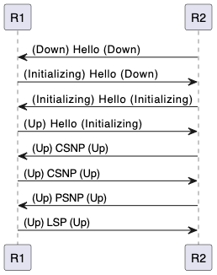
Adjacency Formation Rules
Adjacencies are formed by exchanging IIH PDUs
L1 routers will not form an adjacency with an L2 router
Similarly, L2 routers will not form an adjacency with an L1 router
For L1 adjacencies to form, the configured area ID must be identical
For L2 adjacencies, the area ID may be the same or different

Slide 4
The DIS
Recall from our IS-IS overview that there exists a concept similar to the OSPF DR in IS-IS, which is called the Designated Intermediate System or DIS.
The DIS is elected using the priority value included in IIH PDUs. The highest priority value advertised wins the election
In the event of a priority tie, the node with the highest MAC address wins the election
In the OSI protocol suite, the MAC address is called the Subnet Point of Attachment.
A separate DIS is elected for L1 and L2 adjacencies, though this may result in the same IS being elected for both
Much like in OSPF, the DIS represents the broadcast network segment as a pseudonode

Slide 5
The DIS Cont.
Unlike OSPF, IS-IS routers connected to a broadcast segment form an adjacency with all nodes on the segment.
In OSPF, a full adjacency is only formed with the DR
Also unlike OSPF, IS-IS does not elect a backup to the DIS
In OSPF, a DR and BDR are elected
If the DIS fails, a new DIS is elected at that time
DISs will be preempted if a new router is attached with a higher priority

Slide 6
IS-IS Metrics
Default ‘narrow’ metrics for IS-IS allow for a maximum metric value of 63 for a link
The total maximum metric of a computed path is 1023
Metrics in IS-IS are arbitrary and set by the administrator
In Junos, the metrics can be linked to a reference bandwidth
Metrics are simply summed for all links in a path to compute the cost
The default ‘narrow’ metrics are generally insufficient for todays high-speed networks
‘Wide’ metrics may be configured, increasing the maximum link metric value to 2^24 (~16 million)
The maximum metric of a computed path with wide metrics is 2^32 (~4.3 billion)

